Slide 1

NJIT Investment Fund
Volatility Report

Slide 2
What is Volatility?
Volatility is often associated with big swings in price in either direction
Volatility is measured using the standard deviation or the variance
It is a measure of the difference in adjusted prices over time as well as how often it goes through the price cycles
Important Things to look out for:
High Difference between 52 High/Low Prices
Industry with fast moving market share

Slide 3
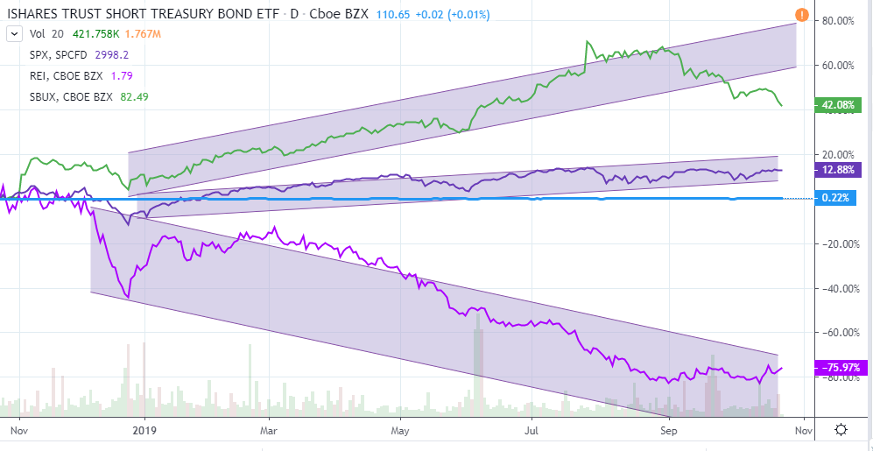
What is Volatility?

Slide 4
How It’s Calculated
Adjusted Closing Prices % Change

Slide 5
How It’s Calculated
Standard Deviation

Slide 6
How It’s Calculated
Covariance

Slide 7
How It’s Calculated
Variance

Slide 8
Our Current Report (Standard Dev)

Slide 9
Our Current Report (Variance/Covariance)

